Slide 1



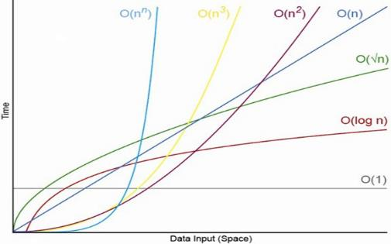
Data Structures, Algorithms and Complexity
O(n)
Analyzing Algorithm Complexity. Asymptotic Notation
Data
Structures
SoftUni Team
Technical Trainers
Software University
http://softuni.bg

Slide 2

Table of Contents
Data Structures Overview
Linear Structures, Trees, Hash Tables, Others
Algorithms Overview
Sorting and Searching, Combinatorics, Dynamic Programming, Graphs, Others
Algorithms Complexity
Time and Memory Complexity
Mean, Average and Worst Case
Asymptotic Notation O(g)
O(n)

Slide 3
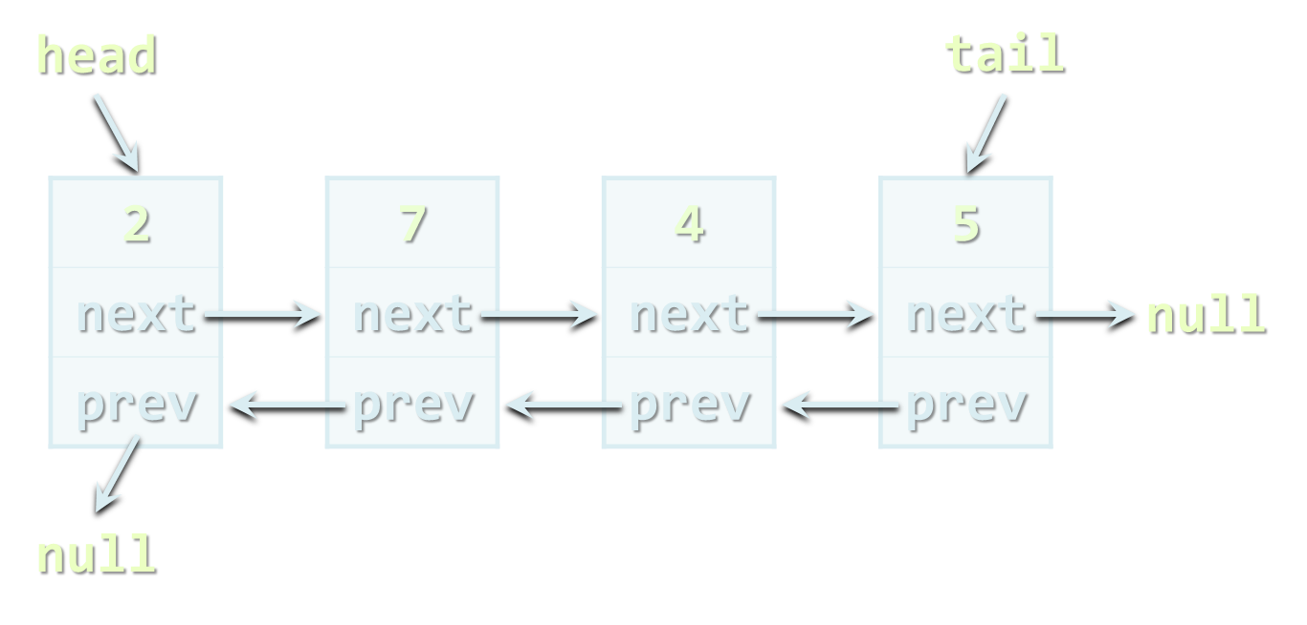
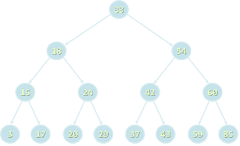
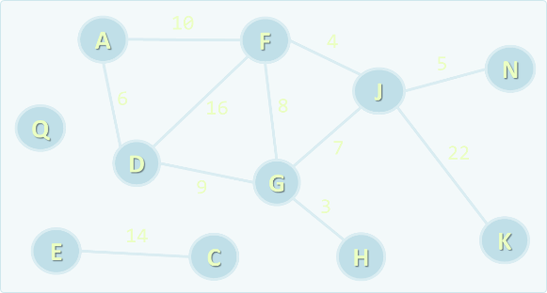
Data Structures
Overview

Slide 4
What is a Data Structure?
“In computer science, a data structure is a particular way of storing and organizing data in a computer so that it can be used efficiently.”
-- Wikipedia
Examples of data structures:
Person structure (first name + last name + age)
Array of integers – int[]
List of strings – List<string>
Queue of people – Queue<Person>

Slide 5
Why Are Data Structures So Important?
Data structures and algorithms are the foundation of computer programming
Algorithmic thinking, problem solving and data structures are vital for the software engineers
C# developers should know when to use T[], LinkedList<T>, List<T>, Stack<T>, Queue<T>, Dictionary<K, T>, HashSet<T>, SortedDictionary<K, T> and SortedSet<T>
Computational complexity is important for algorithm design and efficient programming

Slide 6

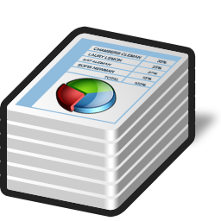

Primitive Types and Collections
Primitive data types
Numbers: int, float, double, decimal, …
Text data: char, string, …
Simple structures
A group of primitive fields stored together
E.g. DateTime, Point, Rectangle, Color, …
Collections
A set / sequence of elements (of the same type)
E.g. array, list, stack, queue, tree, hash-table, bag, …

Slide 7

Abstract Data Types (ADT)
An Abstract Data Type (ADT) is
A data type together with the operations, whose properties are specified independently of any particular implementation
ADT is a set of definitions of operations
Like the interfaces in C# / Java
Define what we can do with the structure
ADT can have several different implementations
Different implementations can have different efficiency, inner logic and resource needs
abstract data

Slide 8

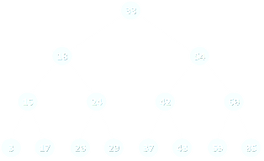

Basic Data Structures
Linear structures
Lists: fixed size and variable size sequences
Stacks: LIFO (Last In First Out) structures
Queues: FIFO (First In First Out) structures
Trees and tree-like structures
Binary, ordered search trees, balanced trees, etc.
Dictionaries (maps, associative arrays)
Hold pairs (key → value)
Hash tables: use hash functions to search / insert

Slide 9



Basic Data Structures (2)
Sets, multi-sets and bags
Set – collection of unique elements
Bag – collection of non-unique elements
Ordered sets, bags and dictionaries
Priority queues / heaps
Special tree structures
Suffix tree, interval tree, index tree, trie, rope, …
Graphs
Directed / undirected, weighted / unweighted, connected / non-connected, cyclic / acyclic, …

Slide 10



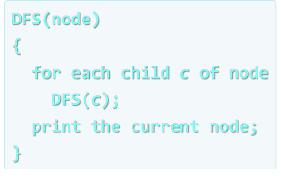
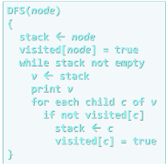

Algorithms
Overview

Slide 11
What is an Algorithm?
“In mathematics and computer science, an algorithm is a step-by-step procedure for calculations. An algorithm is an effective method expressed as a finite list of well-defined instructions for calculating a function.”
-- Wikipedia
The term "algorithm" means "a sequence of steps"
Derived from Muḥammad Al-Khwārizmī', a Persian mathematician and astronomer
He described an algorithm for solving quadratic equations in 825

Slide 12
Algorithms in Computer Science
Algorithms are fundamental in programming
Imperative (traditional, algorithmic) programming means to describe in formal steps how to do something
Algorithm == sequence of operations (steps)
Can include branches (conditional blocks) and repeated logic (loops)
Algorithmic thinking (mathematical thinking, logical thinking, engineering thinking)
Ability to decompose the problems into formal sequences of steps (algorithms)

Slide 13
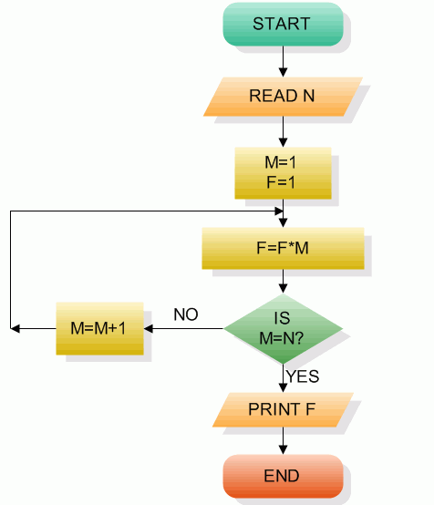
Pseudocode and Flowcharts
Algorithms can be expressed as pseudocode, through flowcharts or program code
BFS(node)
{
queue ← node
while queue not empty
v ← queue
print v
for each child c of v
queue ← c
}
public void DFS(Node node)
{
Print(node.Name);
for (int i = 0; i < node.
Children.Count; i++)
{
if (!visited[node.Id])
DFS(node.Children[i]);
}
visited[node.Id] = true;
}
Example of pseudocode
Example of flowchart
Example of source code

Slide 14


Algorithms in Programming
Sorting and searching
Dynamic programming
Graph algorithms
DFS and BFS traversals
Combinatorial algorithms
Recursive algorithms
Other algorithms
Greedy algorithms, computational geometry, randomized algorithms, parallel algorithms, genetic algorithms

Slide 15

Algorithm Complexity
Asymtotic Notation

Slide 16



Algorithm Analysis
Why we should analyze algorithms?
Predict the resources the algorithm will need
Computational time (CPU consumption)
Memory space (RAM consumption)
Communication bandwidth consumption
The expected running time of an algorithm is:
The total number of primitive operations executed (machine independent steps)
Also known as algorithm complexity

Slide 17
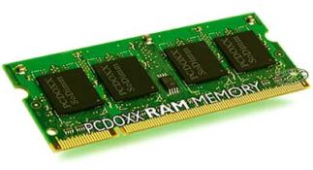
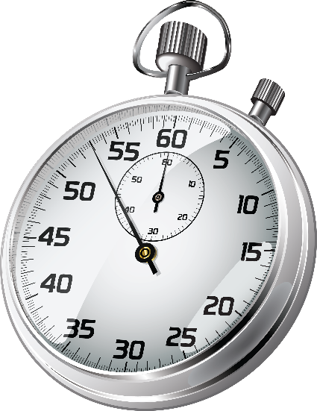
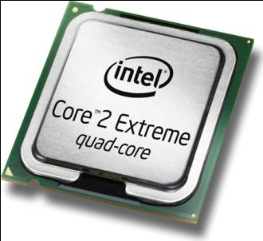
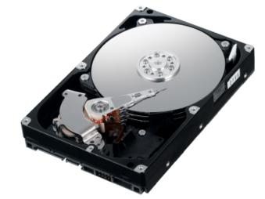
Algorithmic Complexity
What to measure?
CPU time
Memory
Number of steps
Number of particular operations
Number of disk operations
Number of network packets
Asymptotic complexity

Slide 18
Time Complexity
Worst-case
An upper bound on the running time for any input of given size
Typically algorithms performance is measured for their worst case
Average-case
The running time averaged over all possible inputs
Used to measure algorithms that are repeated many times
Best-case
The lower bound on the running time (the optimal case)

Slide 19

Time Complexity – Example
Sequential search in a list of size n
Worst-case:
n comparisons
Best-case:
1 comparison
Average-case:
n/2 comparisons
The algorithm runs in linear time
Linear number of operations
… | … | … | … | … | … | …
n

Slide 20
Algorithms Complexity
Algorithm complexity is a rough estimation of the number of steps performed by given computation, depending on the size of the input
Measured with asymptotic notation
O(g) where g is a function of the size of the input data
Examples:
Linear complexity O(n)
All elements are processed once (or constant number of times)
Quadratic complexity O(n²)
Each of the elements is processed n times

Slide 21
Asymptotic Notation: Definition
Asymptotic upper bound
O-notation (Big O notation)
For given function g(n), we denote by O(g(n)) the set of functions that are different than g(n) by a constant
Examples:
3 * n² + n/2 + 12 ∈ O(n²)
4*n*log₂(3*n+1) + 2*n-1 ∈ O(n * log n)
O(g(n)) = {f(n): there exist positive constants c and n₀ such that f(n) <= c*g(n) for all n >= n₀}

Slide 22
Typical Complexities
Complexity | Notation | Description
constant | O(1) | Constant number of operations, not depending on the input data size, e.g. n = 1 000 000 → 1-2 operations
logarithmic | O(log n) | Number of operations proportional to log₂(n) where n is the size of the input data, e.g. n = 1 000 000 000 → 30 operations
linear | O(n) | Number of operations proportional to the input data size, e.g. n = 10 000 → 5 000 operations

Slide 23
Typical Complexities (2)
Complexity | Notation | Description
quadratic | O(n²) | Number of operations proportional to the square of the size of the input data, e.g. n = 500 → 250 000 operations
cubic | O(n³) | Number of operations propor-tional to the cube of the size of the input data, e.g. n = 200 → 8 000 000 operations
exponential | O(2^{n}), O(k^{n}), O(n!) | Exponential number of operations, fast growing, e.g. n = 20 → 1 048 576 operations

Slide 24
Time Complexity and Program Speed
Complexity | 10 | 20 | 50 | 100 | 1 000 | 10 000 | 100 000
O(1) | < 1 s | < 1 s | < 1 s | < 1 s | < 1 s | < 1 s | < 1 s
O(log(n)) | < 1 s | < 1 s | < 1 s | < 1 s | < 1 s | < 1 s | < 1 s
O(n) | < 1 s | < 1 s | < 1 s | < 1 s | < 1 s | < 1 s | < 1 s
O(n*log(n)) | < 1 s | < 1 s | < 1 s | < 1 s | < 1 s | < 1 s | < 1 s
O(n²) | < 1 s | < 1 s | < 1 s | < 1 s | < 1 s | 2 s | 3-4 min
O(n³) | < 1 s | < 1 s | < 1 s | < 1 s | 20 s | 5 hours | 231 days
O(2^{n}) | < 1 s | < 1 s | 260 days | hangs | hangs | hangs | hangs
O(n!) | < 1 s | hangs | hangs | hangs | hangs | hangs | hangs
O(n^{n}) | 3-4 min | hangs | hangs | hangs | hangs | hangs | hangs

Slide 25
Time and Memory Complexity
Complexity can be expressed as formula on multiple variables, e.g.
Algorithm filling a matrix of size n * m with the natural numbers 1, 2, … n will run in O(n*m)
Algorithms to traverse graph with n vertices and m edges will take O(n + m) steps
Memory consumption should also be considered, for example:
Running time O(n) & memory requirement O(n²)
n = 50 000 → OutOfMemoryException

Slide 26
The Hidden Constant
A linear algorithm could be slower than quadratic algorithm
The hidden constant could be significant
Example:
Algorithm A performs 100*n steps → O(n)
Algorithm B performs n*(n-1)/2 steps → O(n²)
For n < 200 the algorithm B is faster
Real-world example:
The "insertion sort" is faster than "quicksort" for n < 9

Slide 27
Auto-Grow (Resizable) List
Assume we have and auto-grow list
It has a capacity of n elements (initially 1)
Adding a new element typically takes 1 operation
It doubles its size when its is filled → takes n operations
Capacity = 8
Capacity = 16
3 | -2 | 5 | 11 | 9
3 | -2 | 5 | 11 | 9 | 7 | 2 | 8 | -1
used buffer (Count = 5)
unused buffer
used buffer (Count = 9)
unused buffer

Slide 28
Amortized Complexity
Amortized complexity is the total cost per operation, evaluated over a sequence of operations (average cost)
Example:
Let's examine the auto-grow list (resizable list)
The Add(item) operation typically takes 1 operation
When the list is full, Add(item) + resize takes 1 + n operations
n times Add(item) takes n + 2 + 4 + 8 + … + n steps
Add(item) takes ~ 3 steps average → O(1) amortized complexity

Slide 29
Amortized Complexity – Example
Measuring the steps to execute a series of operations Add(item):
Operation # | 1 | 2 | 3 | 4 | 5 | 6 | 7 | 8 | 9 | 10 | 11 | …
Steps | 1 | 3 | 5 | 1 | 9 | 1 | 1 | 1 | 17 | 1 | 1 | 1
Complexity | O(1) | O(1) | O(1) | O(1) | O(n) | O(1) | O(1) | O(1) | O(n) | O(1) | O(1) | O(1)
Operation # | … | 17 | … | 33 | … | 65 | … | 129 | … | 2^{k}+1
Steps | 1 | 33 | 1 | 65 | 1 | 129 | 1 | 257 | 1 | 1 + 2*2^{k}
Complexity | O(1) | O(n) | O(1) | O(n) | O(1) | O(n) | O(1) | O(n) | O(1) | O(n)
256 times Add(item) takes 256 + 2 + 4 + 8 + 16 + 32 + 64 + 128 + 256 = 766 steps → ~ 3 operations / add → O(1) amortized time

Slide 30
Polynomial Algorithms
A polynomial-time algorithm has worst-case time complexity bounded above by a polynomial function of its input size
Examples:
Polynomial-time: log n, 2n, 3n³ + 4n, 2 * n log n
Non polynomial-time: 2^{n}, 3^{n}, n^{k}, n!
Non-polynomial algorithms hang for large input data sets
W(n) ∈ O(p(n))

Slide 31
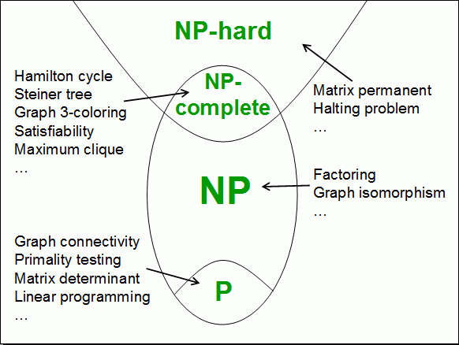
Computational Classes
Computational complexity theory divides the computational problems into several classes:

Slide 32
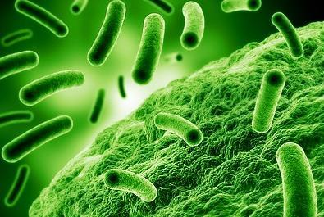
Analyzing Complexity of Algorithms
O(n)
O(n+m)
O(n²)
O(n!)
O(n*m)
Examples

Slide 33
Complexity Examples
int FindMaxElement(int[] array)
{
int max = array[0];
for (int i=0; i<array.length; i++)
{
if (array[i] > max)
{
max = array[i];
}
}
return max;
}
Runs in O(n) where n is the size of the array
The number of elementary steps is ~ n

Slide 34
Complexity Examples (2)
long FindInversions(int[] array)
{
long inversions = 0;
for (int i=0; i<array.Length; i++)
for (int j = i+1; j<array.Length; i++)
if (array[i] > array[j])
inversions++;
return inversions;
}
Runs in O(n²) where n is the size of the array
The number of elementary steps is ~ n * (n+1) / 2

Slide 35
Complexity Examples (3)
decimal Sum3(int n)
{
decimal sum = 0;
for (int a=0; a<n; a++)
for (int b=0; b<n; b++)
for (int c=0; c<n; c++)
sum += a*b*c;
return sum;
}
Runs in cubic time O(n³)
The number of elementary steps is ~ n³

Slide 36
Complexity Examples (4)
long SumMN(int n, int m)
{
long sum = 0;
for (int x=0; x<n; x++)
for (int y=0; y<m; y++)
sum += x*y;
return sum;
}
Runs in quadratic time O(n*m)
The number of elementary steps is ~ n*m

Slide 37
Complexity Examples (5)
long SumMN(int n, int m)
{
long sum = 0;
for (int x=0; x<n; x++)
for (int y=0; y<m; y++)
if (x==y)
for (int i=0; i<n; i++)
sum += i*x*y;
return sum;
}
Runs in quadratic time O(n*m)
The number of elementary steps is ~ n*m + min(m,n)*n

Slide 38
Complexity Examples (6)
decimal Calculation(int n)
{
decimal result = 0;
for (int i = 0; i < (1<<n); i++)
result += i;
return result;
}
Runs in exponential time O(2^{n})
The number of elementary steps is ~ 2^{n}

Slide 39
Complexity Examples (7)
decimal Factorial(int n)
{
if (n==0)
return 1;
else
return n * Factorial(n-1);
}
Runs in linear time O(n)
The number of elementary steps is ~ n

Slide 40
Complexity Examples (8)
decimal Fibonacci(int n)
{
if (n == 0)
return 1;
else if (n == 1)
return 1;
else
return Fibonacci(n-1) + Fibonacci(n-2);
}
Runs in exponential time O(2^{n})
The number of elementary steps is ~ Fib(n+1) where Fib(k) is the k^{th} Fibonacci's number

Slide 41
Summary
Data structures organize data in computer systems for efficient use
Abstract data types (ADT) describe a set of operations
Collections hold a group of elements
Algorithms are sequences of steps for calculating / doing something
Algorithm complexity is a rough estimation of the number of steps performed by given computation
Can be logarithmic, linear, n log n, square, cubic, exponential, etc.
Complexity predicts the speed of given code before its execution

Slide 42









Data Structures, Algorithms and Complexity
https://softuni.bg/trainings/1147/Data-Structures-June-2015

Slide 43
License
This course (slides, examples, labs, videos, homework, etc.) is licensed under the "Creative Commons Attribution-NonCommercial-ShareAlike 4.0 International" license
Attribution: this work may contain portions from
"Fundamentals of Computer Programming with C#" book by Svetlin Nakov & Co. under CC-BY-SA license
"Data Structures and Algorithms" course by Telerik Academy under CC-BY-NC-SA license

Slide 44





Free Trainings @ Software University
Software University Foundation – softuni.org
Software University – High-Quality Education, Profession and Job for Software Developers
softuni.bg
Software University @ Facebook
facebook.com/SoftwareUniversity
Software University @ YouTube
youtube.com/SoftwareUniversity
Software University Forums – forum.softuni.bg

